Slide 1
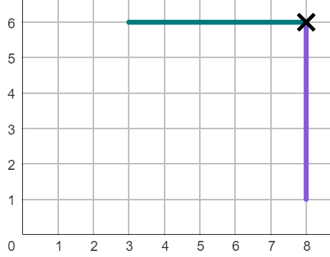

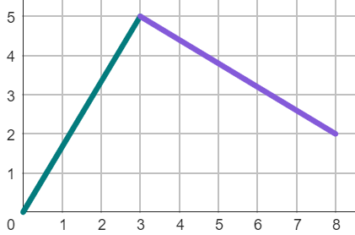
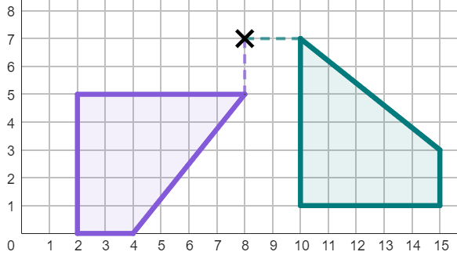
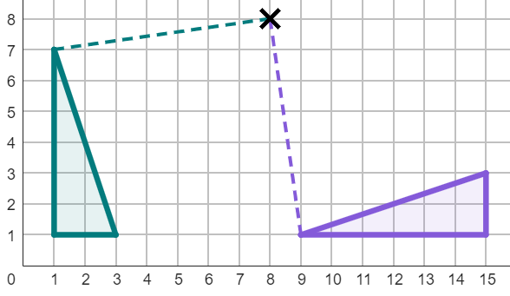
Understanding the centre of rotation
Task A: Describing with the centre of rotation
1) The line has been rotated less than 360°.
Complete the information for the rotation of this line:
The object has been rotated:
anti-clockwise by °
with a centre of rotation at .
2) The line has been rotated less than 360°.
Complete the information for the rotation of this line:
The object has been rotated:
clockwise by °
with a centre of rotation at .
3) The object has been rotated less than 360°.
Complete the information for the rotation:
The object has been rotated:
clockwise by °
with a centre of rotation at .
4) The object has been rotated less than 360°.
Complete the information for the rotation:
The object has been rotated:
anti-clockwise by °
with a centre of rotation at .
1

Slide 2
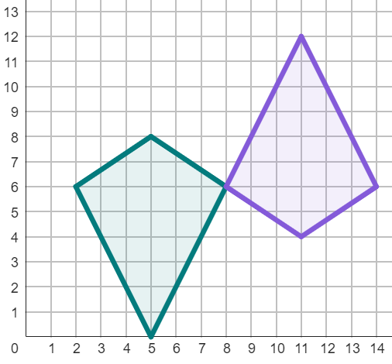
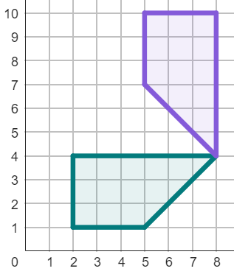
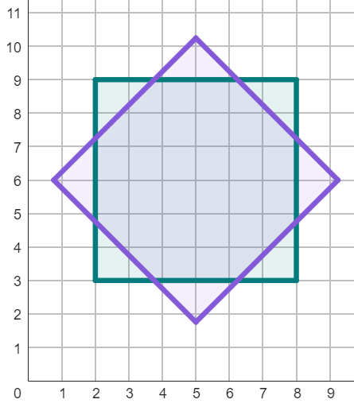
Understanding the centre of rotation
5) There are lots of ways to fully describe this rotation. Complete these two descriptions:
The object has been rotated:
clockwise by °
with a centre of rotation at .
The object has been rotated:
anti-clockwise by °
with a centre of rotation at .
6) There are two ways of describing this rotation, if done in less than a full turn. Complete both descriptions:
The object has been rotated:
clockwise by °
with a centre of rotation at .
The object has been rotated:
image
object
7) There are multiple possible descriptions that could correctly describe this rotation. Fully describe this rotation in one way.
The object has been rotated:
by °
with a centre of rotation at .
image
object
2

Slide 3
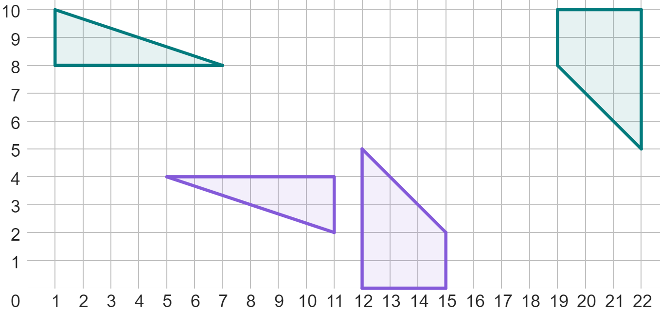
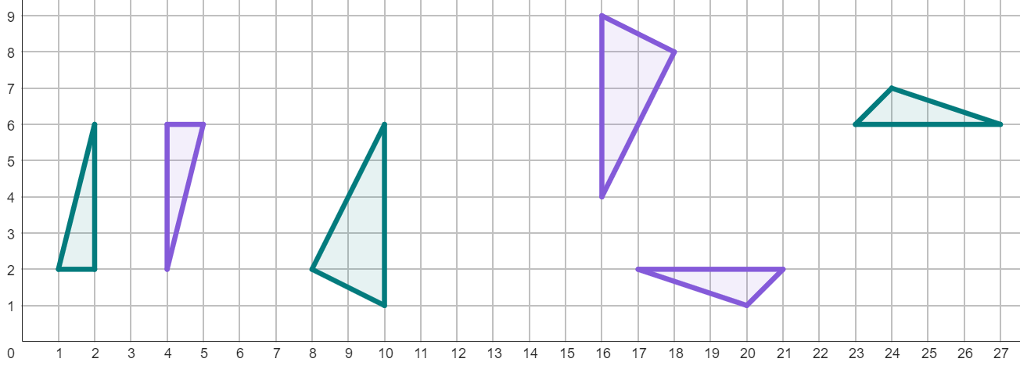
Understanding the centre of rotation
Task B: Finding the centre of rotation for 180° rotations
1) Below are two rotations where an object and its image have two pairs of corresponding vertices labelled. By connecting these corresponding vertices with line segments, find the centre of rotation of each object.
A
B
C
D′
A′
D
B′
C′
2) By connecting corresponding points on the object and image, find the centre of rotation for these rotations.
3) Complete the sentence below:
“To find the centre of rotation by connecting corresponding points, the image must have been rotated by °.”
3

Slide 4
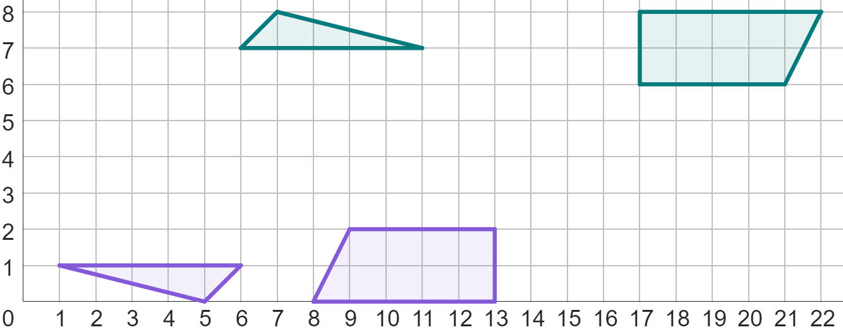
Understanding the centre of rotation
4) Fully describe these rotations.
object 1
object 2
Description for object 1
Description for object 2
Mathematics in Education and Industry
4
v2.2

